Slide 1
Lymphatic
System
Aka Immune System

Slide 2
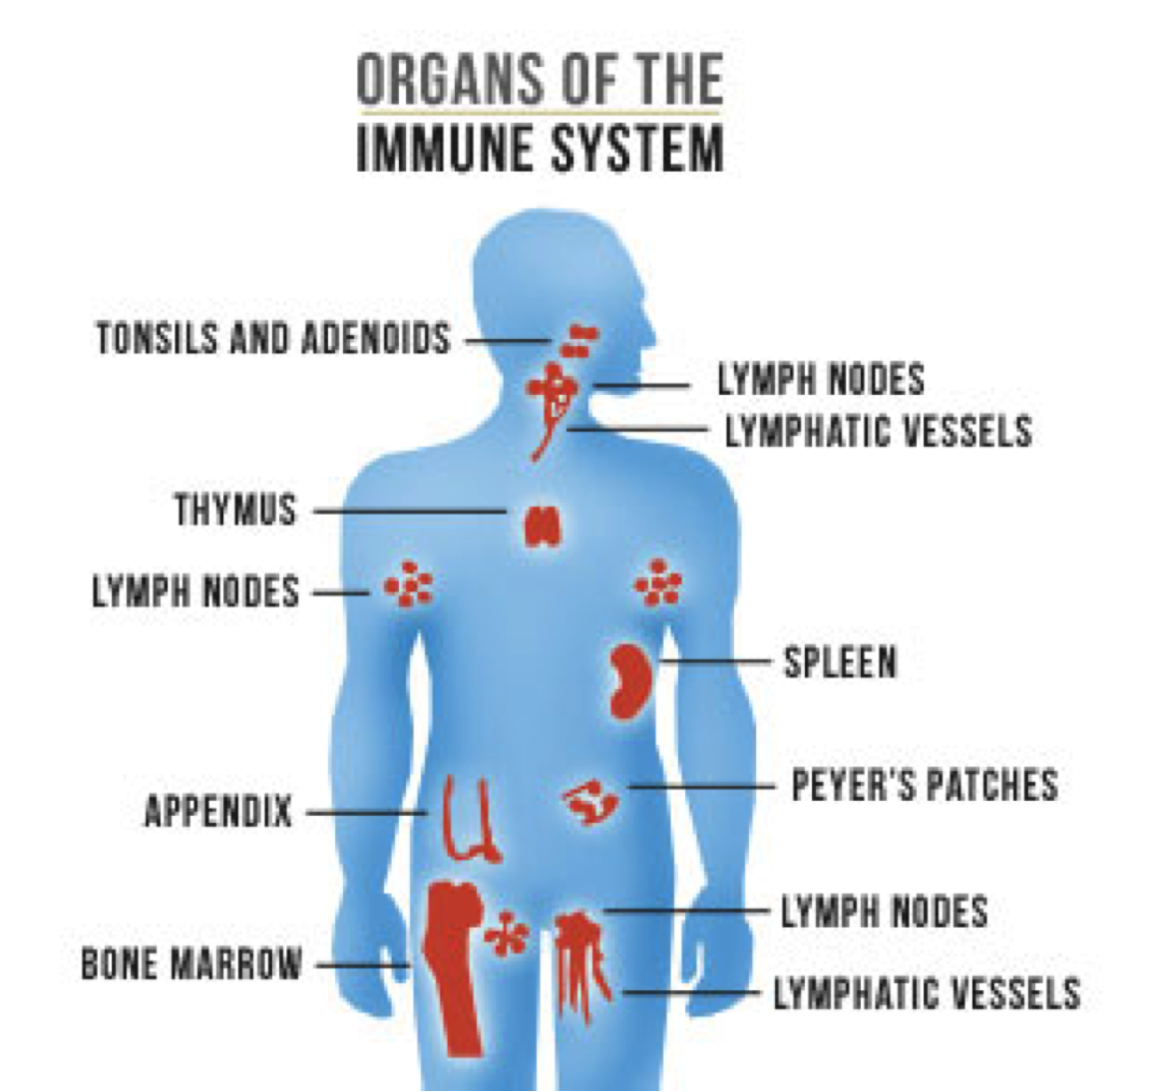
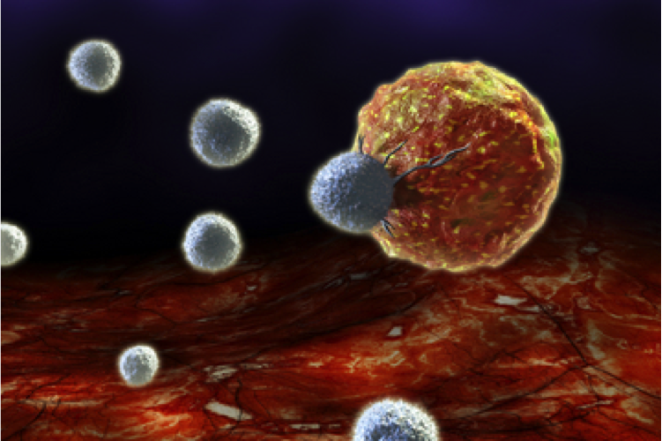

Slide 3
Immune system function
PROTECTS THE BODY FROM DISEASE
COLLECTS FLUID LOST FROM BLOOD VESSELS AND RETURNS IT TO CIRCULATORY SYSTEM

Slide 4
MAIN ORGANS OF THE IMMUNE SYSTEM
WHITE BLOOD CELLS
- Fight off invaders, foreign bodies, bacteria
- Produce antibodies
THYMUS
- Produces white blood cells
SPLEEN
- Fights bacteria
- Recycles old blood
- Stores white blood cells
LYMPH NODES
- Makes lymphocytes which defend body from bacteria and other microorganisms and filters them out of the blood
LYMPH VESSELS
- Transports lymph and other immune fluids throughout the body

Slide 5
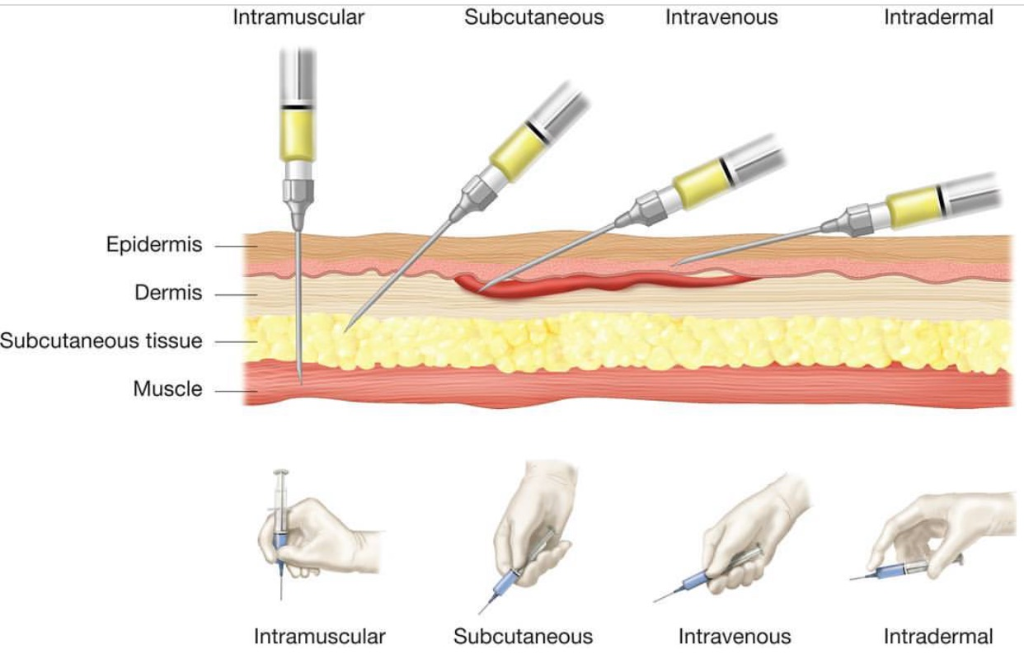
Why get vaccinated?
Thanks to vaccines, many diseases have been nearly eliminated.
Vaccines save lives by preventing outbreaks of disease and protecting those who cannot be vaccinated.
A vaccine is a product that produces immunity from a disease and can be administered through needle injections, by mouth, or by aerosol.
A vaccination is the injection of a killed or weakened organism that produces immunity in the body against that organism.
An immunization is the process by which a person or animal becomes protected from a disease. Vaccines cause immunization, and there are also some diseases that cause immunization after an individual recovers from the disease.

Slide 6
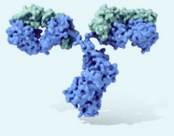
What is an antibody?
Antibodies are produced by the immune system in response to the presence of an antigen. Antigens are large molecules, usually proteins, on the surface of cells, viruses, fungi, bacteria, and some non-living substances such as toxins, chemicals, and foreign particles. Any substance capable of triggering an immune response is called an antigen.

Slide 7
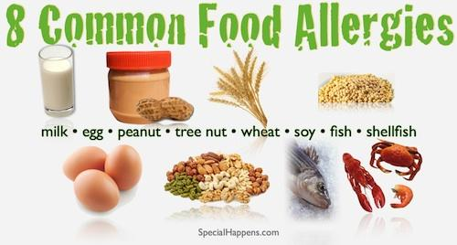

Slide 8
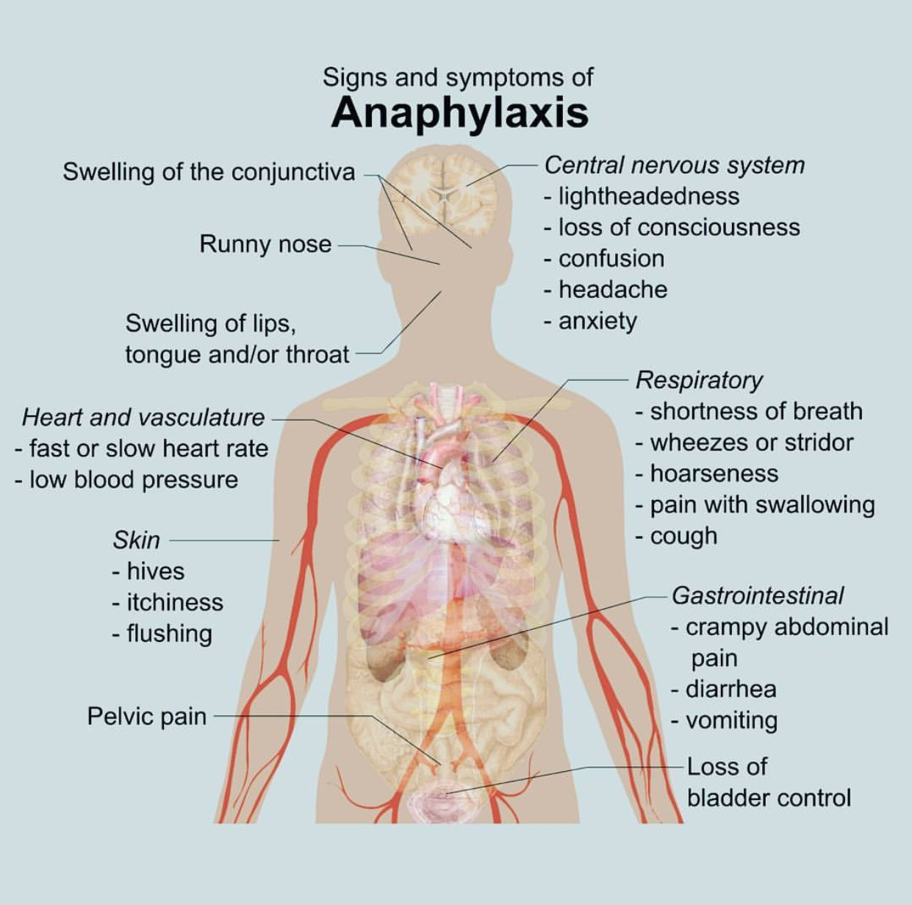

Slide 9
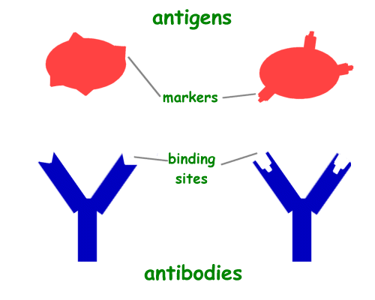
The overuse of antibiotics — especially taking antibiotics even when they're not the appropriate treatment — promotes antibiotic resistance.
https://www.youtube.com/watch?v=znnp-Ivj2ek
https://www.youtube.com/watch?v=uDxQT1MRwhk

Slide 10
Specialized Cells of the Immune System
Leukocytes- White blood cells produced in the bone marrow that provide the body with immunity.
B Cells-B cells spend their entire early life in the bone marrow. Upon maturity, their job is to travel throughout the blood and lymph looking for antigens. Once a B cell has identified an antigen, it starts replicating itself. These cloned cells mature into antibody-manufacturing plasma cells.
Helper T Cells-These cells travel through the blood and lymph, looking for antigens. Upon locating an antigen, they notify other cells to assist in combating the invader.

Slide 11
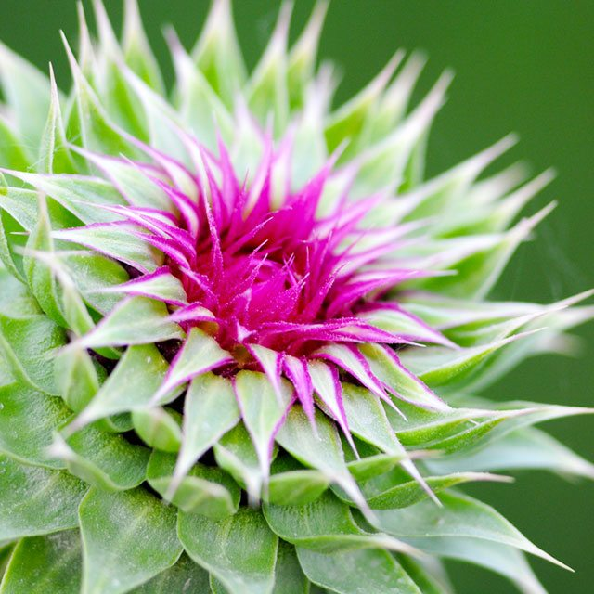
Comparative anatomy
All animals have an immune system as a response to fight off invaders.
Plants will also respond to foreign microbes by activating resistance genes in an attempt to fight back, closing stomata to limit bacterial entry or self destructing to prevent the spread throughout the community.

Slide 12
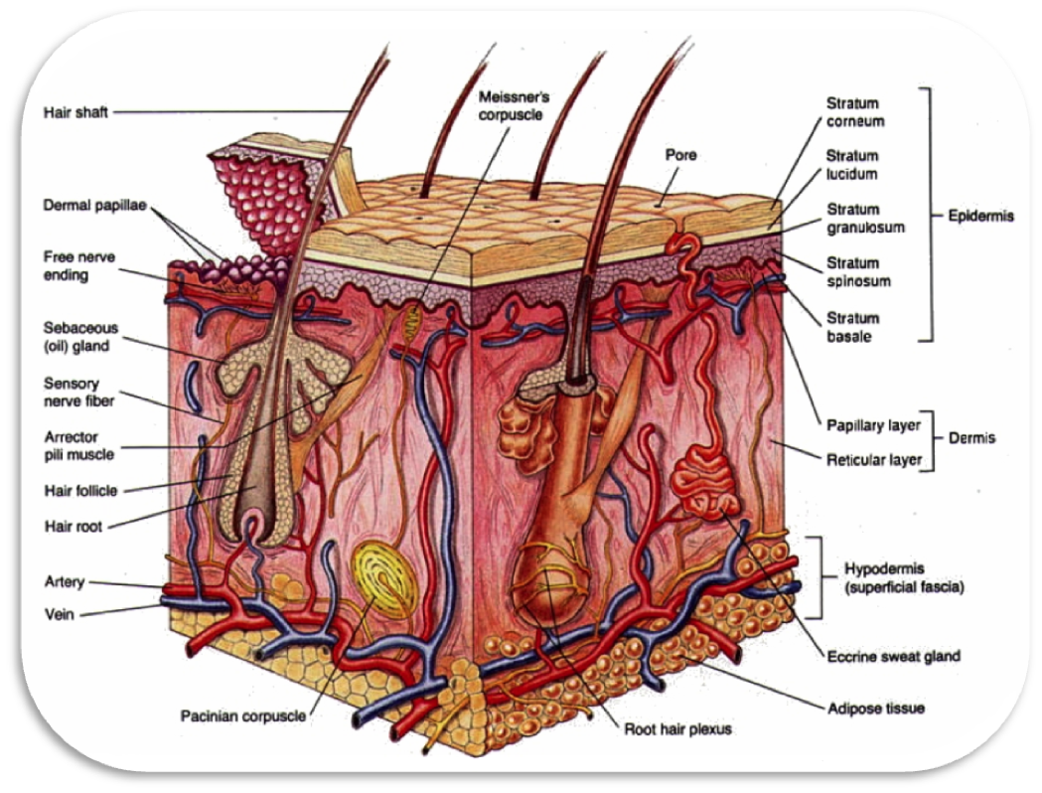
Integumentary System

Slide 13
Integumentary system function
GUARDS AGAINST INFECTION, INJURY AND UV RADIATION
HELPS REGULATE BODY TEMPERATURE

Slide 14
Organs of the Integumentary System
SKIN
- Controls UV Radiation using Melanin and Melanocytes
- Holds water inside body
- Protects body from infection
HAIR
- Helps regulate body temperature
- Protects open entries into body from infection and invaders
NAILS
- Modified Claws
- Evolutionary Leftover
OIL AND SWEAT GLANDS
- Regulate temperature
- Protect skin, makes it waterproof
- Keeps skin from drying out

Slide 15
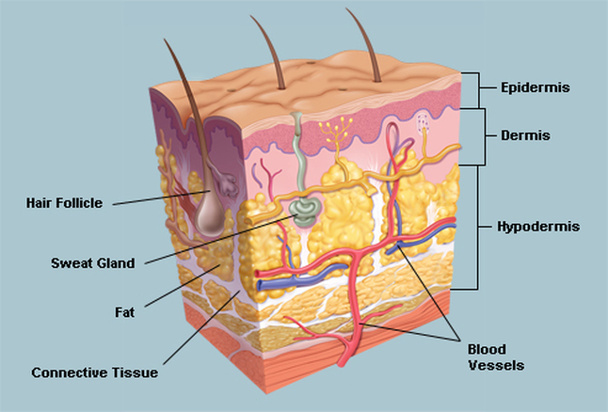
Skin has three layers:
The epidermis, the outermost layer of skin, provides a waterproof barrier and creates our skin tone.
The dermis, beneath the epidermis, contains tough connective tissue, hair follicles, and sweat glands.
The deeper subcutaneous tissue (hypodermis) is made of fat and connective tissue.

Slide 16
Systems it works with
Endocrine system-glands near the skin’s surface will release oils that decrease your skin’s pH to kill microorganisms
Lymphatic System-first line of defense against harmful bacteria
Muscular System- skin is attached to muscles as a layer of protection
Circulatory System-Capillaries near the surface of the skin open when your body needs to cool off and close when you nee-d to conserve heat.
Nervous System-Your central nervous system depends on neurons embedded in your peripheral nervous system, in this case-skin to sense the outside world

Slide 17
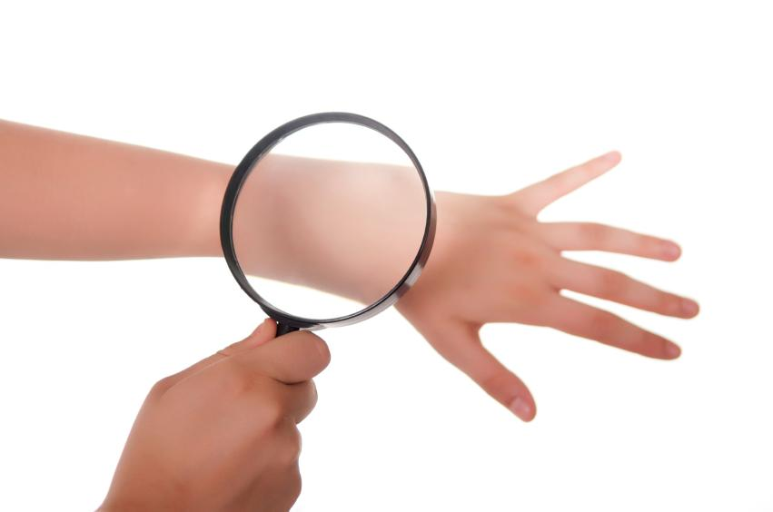
Cool facts
The system also protects your body from dehydration, overheating, or freezing. The layer of skin can sweat and help your body cool or surround a layer of fat that keeps warmer temperatures inside. Did you know your skin makes up over fifteen percent of your body weight and is the largest organ in your body?

Slide 18
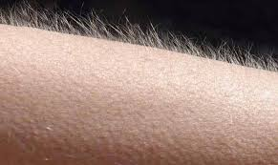
Why do humans have goosebumps?
Is it helpful?
When would it be
helpful?

Slide 19
Comparative anatomy
All organisms in the animal kingdom have some sort of protective outer lining to their body. This includes insects and crustaceans with their exoskeletons.
Plants have an outer lining similar to skin
that will allow heat to escape if the plant
Is too warm. It is also a form of protection.

