Slide 1
Read Article & Discuss
Natural Selection vs. Mutation
How can mutations be a good thing?
How does evolution rely on mutation?
“We are all mutants”
True/False?
Good/Bad?

Slide 2
Online Notes - iPads
Can organisms decide or choose what mutations they get?
Is every mutation important?
What kinds of effects can mutations have?

Slide 3
Not All Mutations Are Bad
A PSA

Slide 4
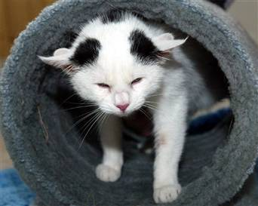
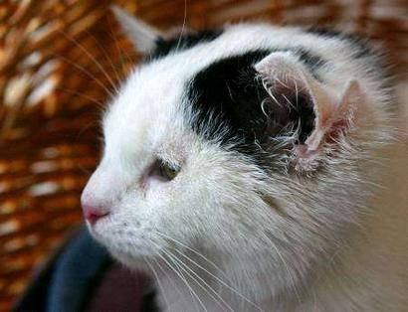
4 Ears
http://www.youtube.com/watch?v=ibdRm71WCN4&amp;feature=related
Video of Lilly
Notes:
A kitten born on a farm in Germany has an extra pair of ears!1 ‘Lilly’ is perfectly healthy. The extra ears do not hear; only her usual ears, and they hear quite normally.

Slide 5
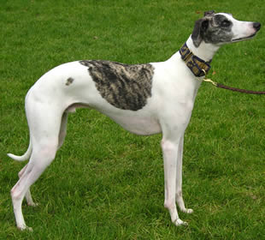
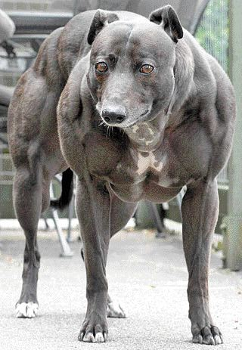
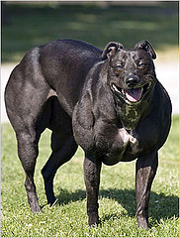
Notes:
Double muscling is a trait previously described in several mammalian species including cattle and sheep and is caused by mutations in the myostatin (MSTN) gene (previously referred to as GDF8). Here we describe a new mutation in MSTN found in the whippet dog breed that results in a double-muscled phenotype known as the “bully” whippet. Individuals with this phenotype carry two copies of a two-base-pair deletion.
http://www.cobankopegi.com/blog/2007/06/bully-whippets-genetics.html

Slide 6
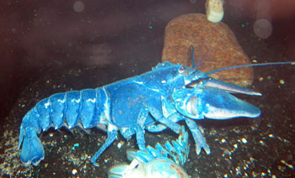
Blue Lobster
Notes:
Around one in two million lobsters is blue. A research study conducted by Professor Ronald Christensen at the University of Connecticut discovered that a genetic defect causes a blue lobster to produce an excessive amount of protein. The protein, and a red caratenoid molecule known as astaxanthin, combine to form a blue complex known as crustacyanin, giving the lobster its blue color.

Slide 7
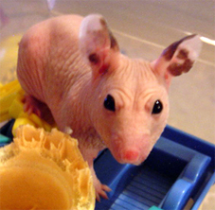
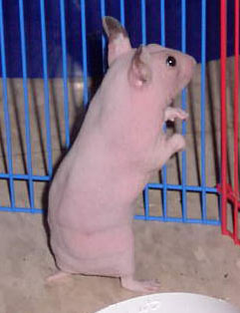
Hairless Hampster
Notes:
A Hairless Syrian is born completely devoid of hair. This is due to a genetic mutation that effects the epidermis (the layer of skin where the hair follicles are).
Some Hairless may have very stubby, curly white whiskers, but often lose these as they mature.
http://www.hamsterific.com/HamsterUniversity/HairlessAlienHamsters.cfm

Slide 8
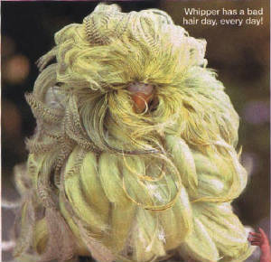
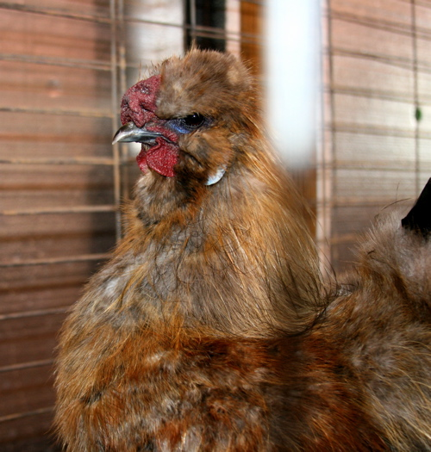
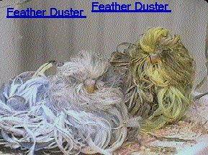
Chickens
Notes:
LEFT: This is a Japanese silky. He's got a genetic mutation that creates feathers without barbules, those little hooks that interlock and keep a feather sleek and smooth.
RIGHT: This chicken(top) & bungies (Bottom) have a natural mutation called “FEATHER DUSTER” They are a very short-lived, about 6-12 weeks. Their feathers don't stop growing.

Slide 9
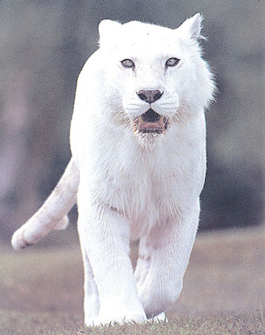
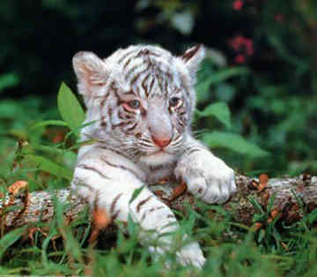
White Tiger
http://www.bigcatrescue.org/video/00186.htm
White tiger video
Notes:
The white color is the result of a double recessive allele (gene) and thus the white color can only be produced by inbreeding one tiger carrying the recessive gene for the white color to another tiger carrying the same recessive gene.
This occurrs about once in every 10,000 births. That statistical approximation is based upon recorded observations in the wild of white cubs. It should be noted that the first recorded observation of a white cub was made in the mid-fifteenth century and the only wild observations of white cubs have been in Bengal tigers.
ALL white tigers are cross eyed, whether it shows or not, because the gene that causes the white coat always causes the optic nerve to be wired to the wrong side of the brain. That is why white tigers are such a favorite of the tiger-tamer-wanabees; they are far more dependant upon their masters.
http://www.bigcatrescue.org/cats/wild/white_tigers.htm

