Slide 1
Nervous system

Slide 2
Recognizes and coordinates the body’s response to changes in its internal and external environments

Slide 3
Two different branches:
Peripheral Nervous System
Nerves
Central Nervous System (CNS)
Brain
Spinal Cord

Slide 4
Main Organs:
Brain: Controls all body function, stores memories, develops personality
Spinal Cord: Connects peripheral nerves to brain; transmits nerve impulses
Peripheral Nerves: sensing changes in environment, send signals to brain

Slide 6
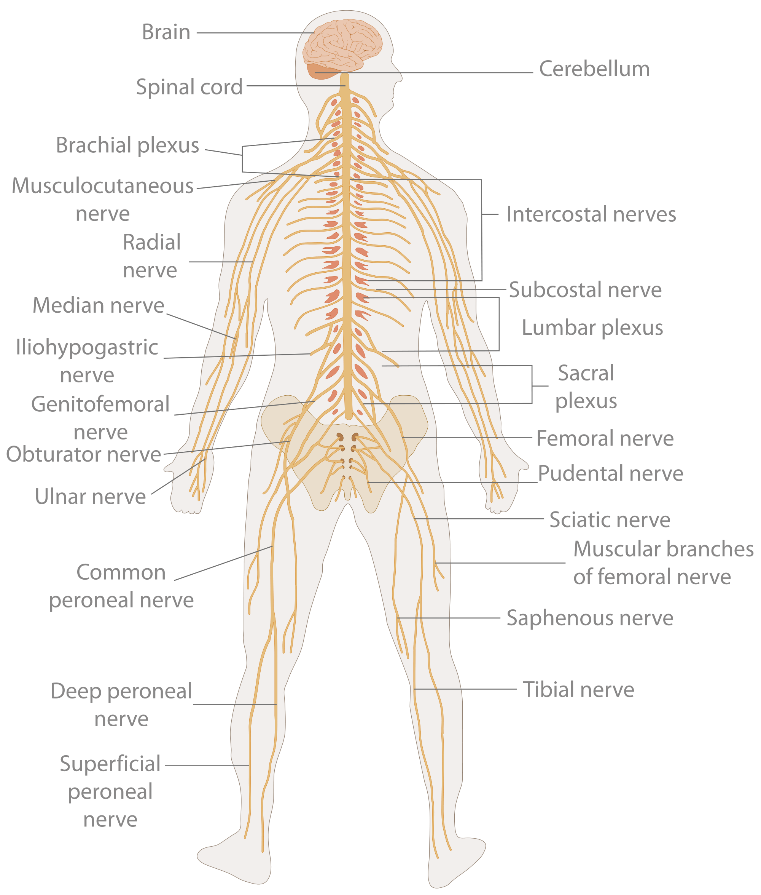

Slide 7
Comparative Anatomy

Slide 8
Other animals (jellyfish, sea sponges, sea urchins) lack brains, but still have a system of nerves to communicate.
Why no brain?
Brains require a lot of ENERGY (food) and some of those animals aren’t able to obtain enough food to provide for it. It was in their evolutionary favor to lose it (or never gain it)

Slide 9
Plants don't really need nervous systems.
Plants communicate with parts of themselves and with other plants through hormones and chemicals

